Slide 1
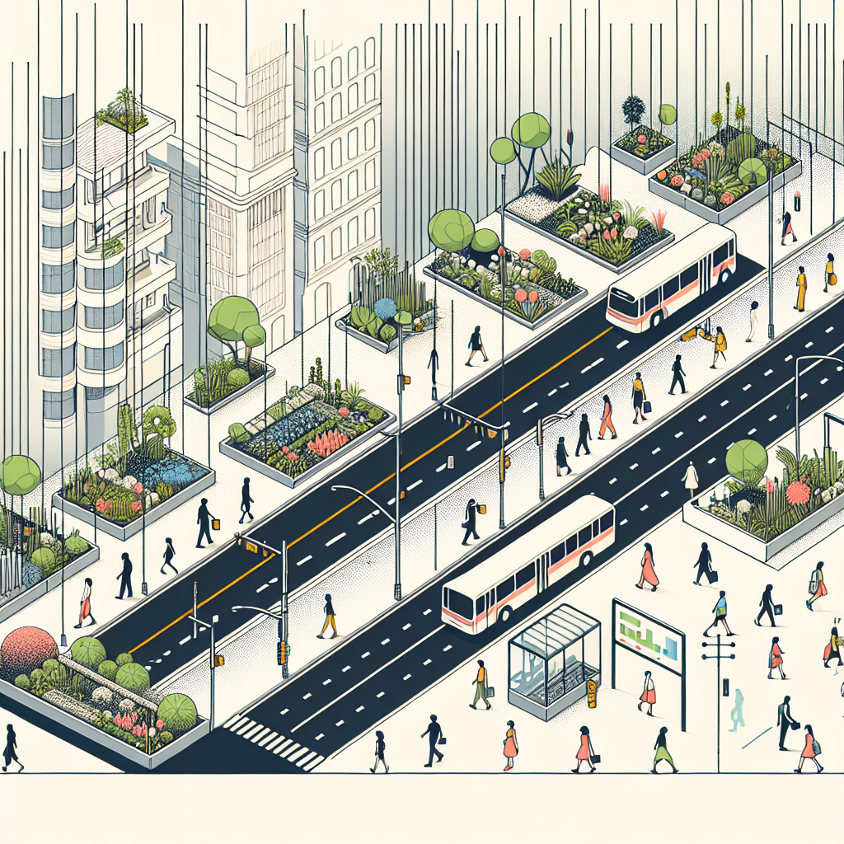
Street Redesign Elements (Complete Streets)
Continuous sidewalks with curb ramps and tactile paving
Protected bike lanes (physical separation) and intersection protection
Bus priority (dedicated lanes, queue jumps), all‑door boarding
Traffic calming: 30 km/h design speeds, raised crossings, chicanes
Curb management: loading bays, micromobility parking, parklets
Green infrastructure: shade trees, bioswales, permeable surfaces
Safety at night: pedestrian‑scale lighting
Cross Section: typical 24 m ROW
Components:
Sidewalk + furnishing: 3.0 m each side
Protected bike track: 1.8 m + 0.5 m buffer each side
Bus lane: 3.0 m each direction
General traffic lane: 2.7 m each direction
Total Width: ≈24.0 m
Note: Adjust widths to local standards; maintain continuous protection at intersections.
Before-After photomontage:
Before: 4 lanes, on‑street parking, discontinuous sidewalk
After: 2 lanes + bus priority, protected bikeways, expanded sidewalks, trees, parklets

